Slide 1
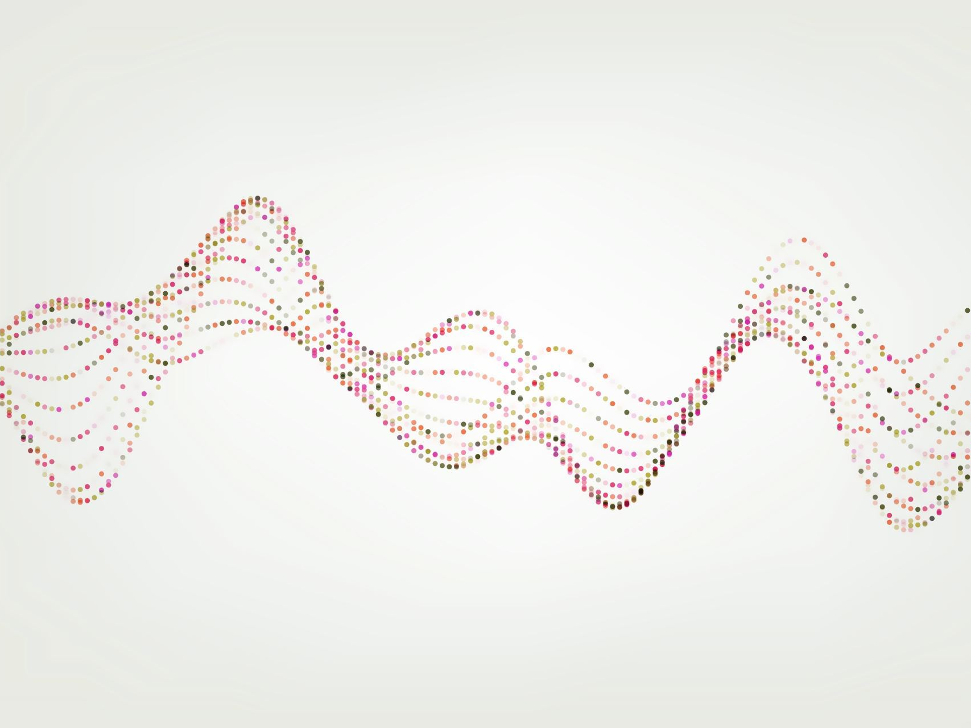
Digital Image Processing
Image Enhancement (Filtering in the Frequency Domain)

Slide 2
Contents
In this lecture we will look at image enhancement in the frequency domain
Jean Baptiste Joseph Fourier
The Fourier series & the Fourier transform
Filtering: Image Processing in the frequency domain
Image smoothing
Image sharpening

Slide 3
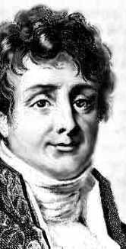
Jean Baptiste Joseph Fourier
Fourier was born in Auxerre, France in 1768
Most famous for his work “La Théorie Analitique de la Chaleur” published in 1822
Translated into English in 1878: “The Analytic Theory of Heat”
Nobody paid much attention when the work was first published
One of the most important mathematical theories in modern engineering

Slide 4
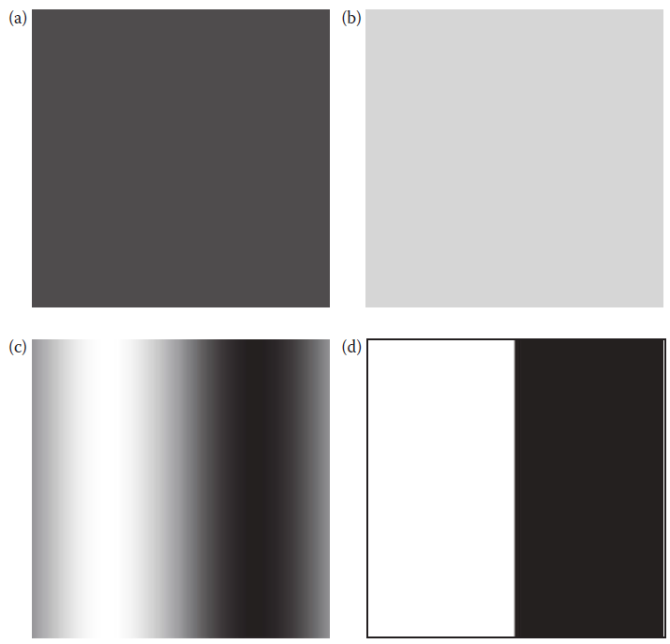
Images have frequencies…really?

Slide 5
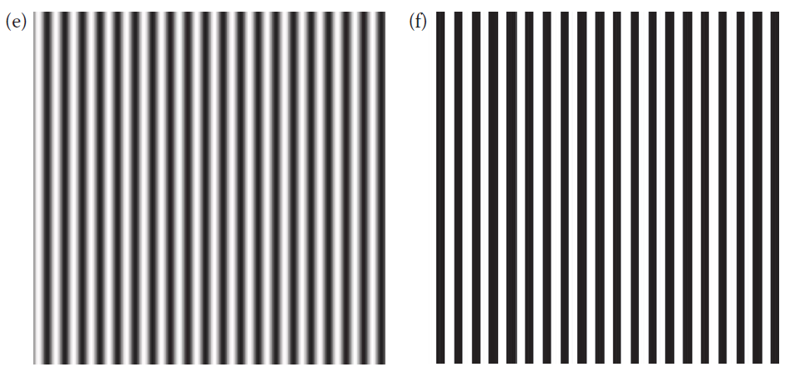
Images have frequencies…really?

Slide 6
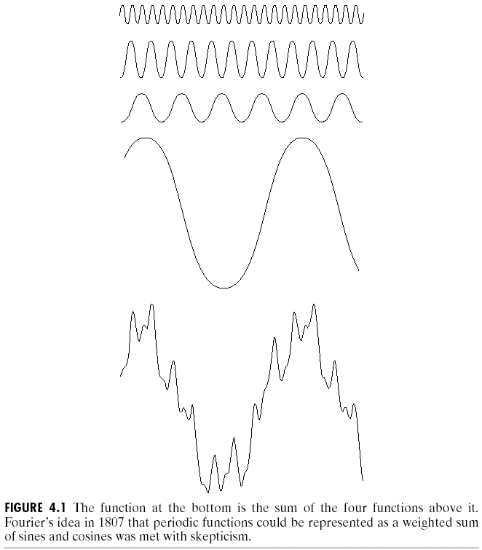
The Big Idea
=
Any function that periodically repeats itself can be expressed as a sum of sines and cosines of different frequencies each multiplied by a different coefficient – a Fourier series
Notes:
https://socratic.org/questions/what-are-polar-coordinates-used-for-in-real-life-1

Slide 7
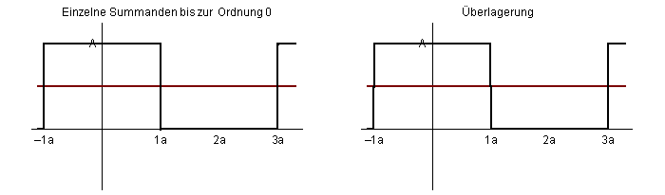
The Big Idea (cont…)
Notice how we get closer and closer to the original function as we add more and more frequencies

Slide 8
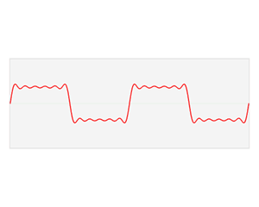
The Big Idea (cont…)

Slide 9
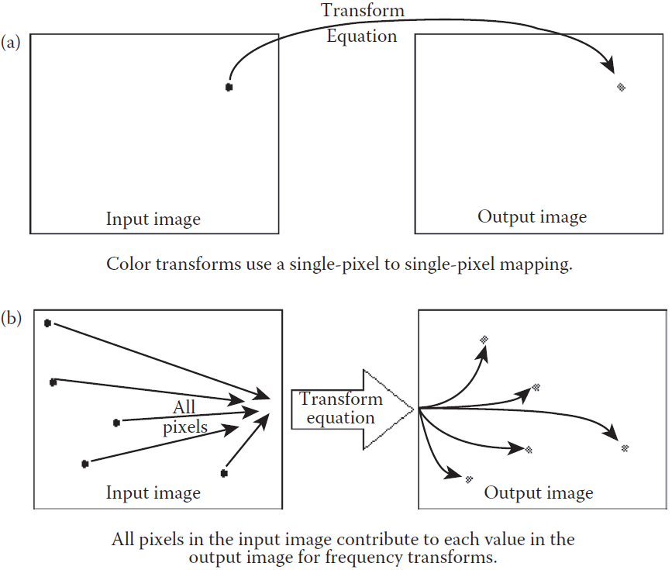
Frequency Transformations

Slide 10
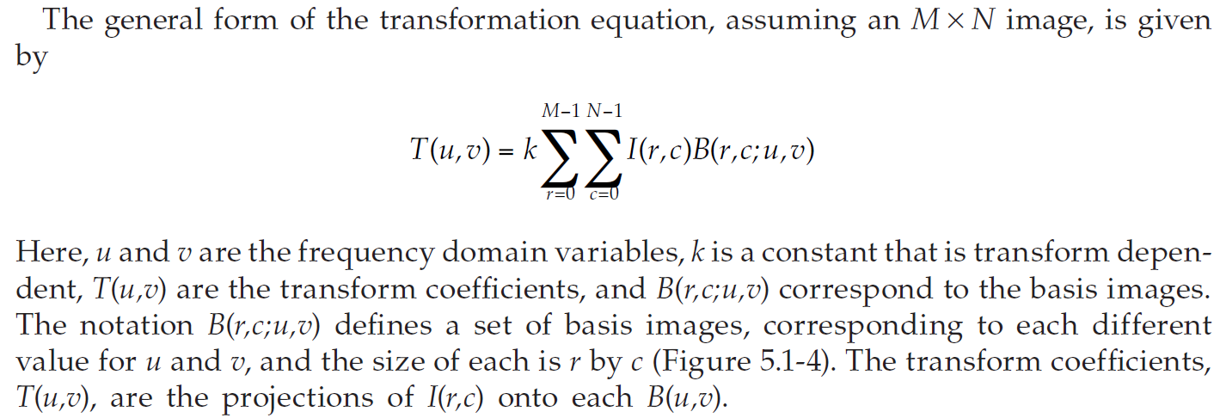
Frequency Transformations
Notes:
The Fourier transformation of an image is a mathematical operation that represents the image in the frequency domain. It decomposes the image into its constituent spatial frequencies, allowing for various image processing tasks such as filtering, compression, and analysis.

Slide 11
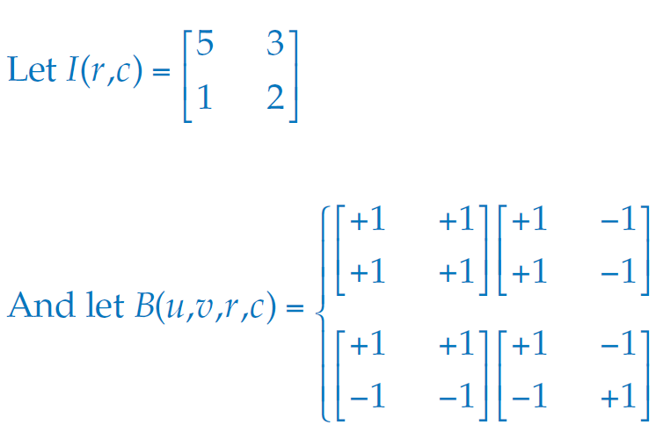
Example Basis Images

Slide 12
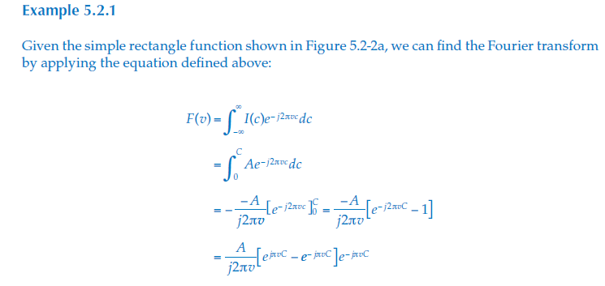
1D Fourier Example

Slide 13
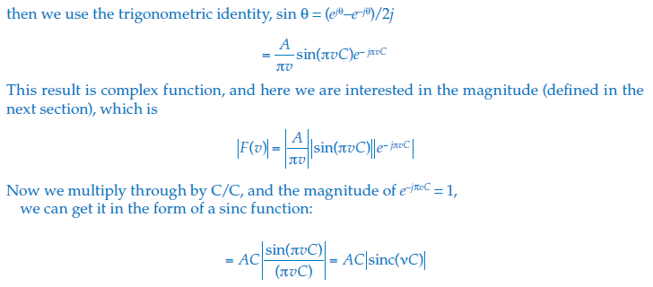
1D Fourier Example...
Notes:
Start with your function �(�)f(x).
Multiply it by �−���e−iωx, where �ω is the frequency at which you want to analyze the signal.
Integrate this product over the entire range of �x from −∞−∞ to +∞+∞.
The result �(�)F(ω) is a complex number. It contains information about how the signal �(�)f(x) is composed of different sinusoidal waves at various frequencies.

Slide 14
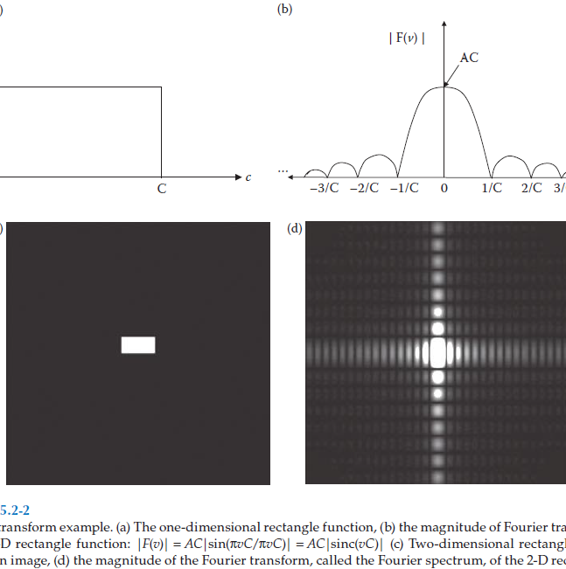
1D Fourier Example

Slide 15
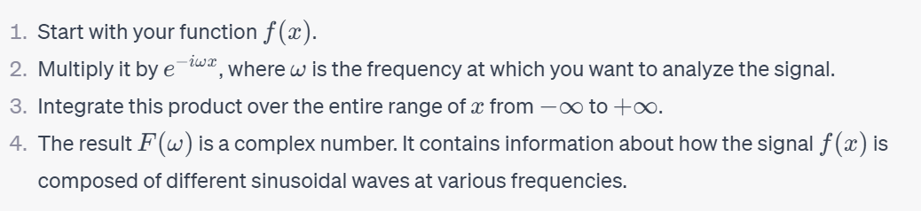
1D Transformation

Slide 16
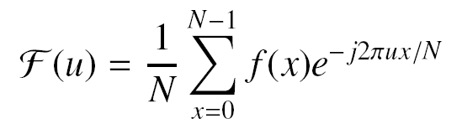
DFT Example
Given a row profile, compute the Fourier coefficients
Index | 0 | 1 | 2 | 3 | 4 | 5 | 6 | 7
Value | 20 | 12 | 18 | 56 | 83 | 10 | 104 | 114

Slide 17
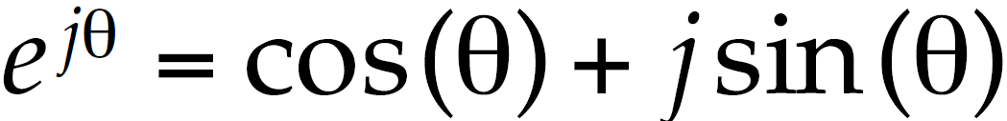
The Discrete Fourier Transform (DFT)
The Discrete Fourier Transform of f(x, y), for x = 0, 1, 2…M-1 and y = 0,1,2…N-1, denoted by F(u, v), is given by the equation:
for u = 0, 1, 2…M-1 and v = 0, 1, 2…N-1.
In this case the basis functions (e^{jθ}) are sinusoidal (as by Euler’s Formula):
Sinusoidal help LINK: http://www.regentsprep.org/regents/math/algtrig/att7/sinusoidal.htm

Slide 18
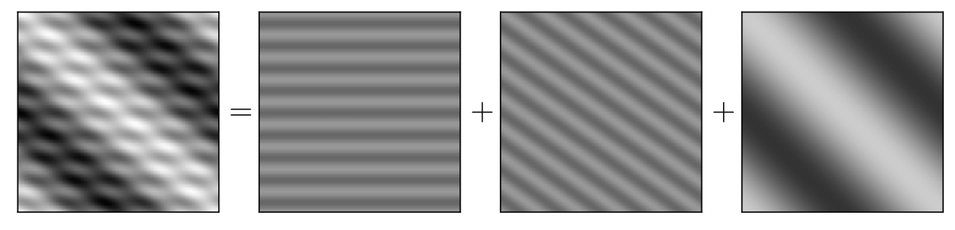
Example

Slide 19
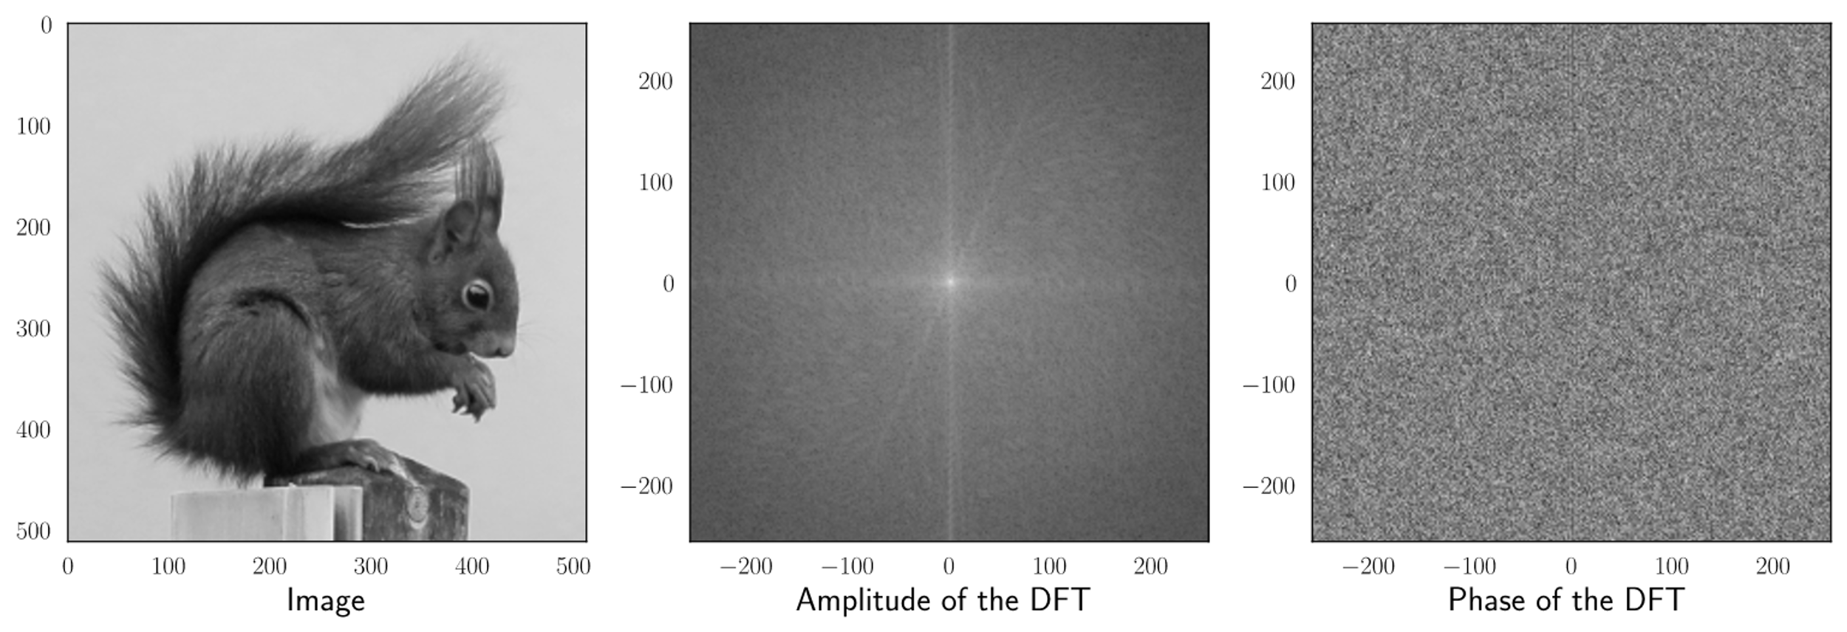
Example...

Slide 20
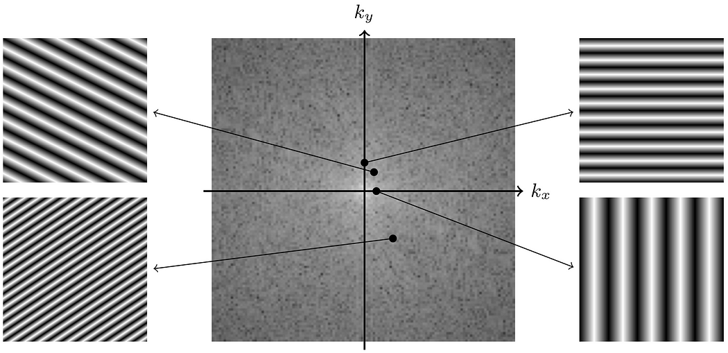
Example...

Slide 21
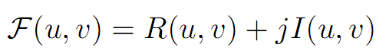
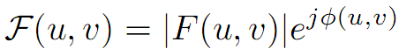
2D DFT
Each DFT coefficient is a complex value
There is a single DFT coefficient for each spatial sample
A complex value is expressed by two real values in either Cartesian or polar coordinate space.
Cartesian: R(u,v) is the real and I(u, v) the imaginary component
Polar: |F(u,v)| is the magnitude and phi(u,v) the phase
Notes:
Start with your 2D image, �(�,�)f(x,y).
Multiply it by �−�(��+��)e−i(ux+vy), where �u and �v are the spatial frequencies in the horizontal and vertical directions, respectively.
Integrate this product over the entire range of �x and �y. In practice, this is often done discretely using numerical methods since images are represented as arrays of pixels.
The result �(�,�)F(u,v) is a complex number at each point (�,�)(u,v) in the frequency domain. It represents how the image �(�,�)f(x,y) is composed of different sinusoidal patterns at different frequencies and orientations.

Slide 22
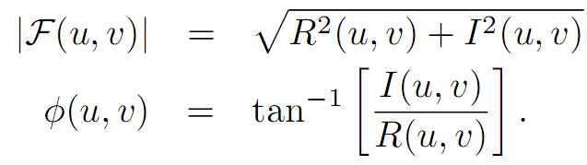
2D DFT
Representing the DFT coefficients as magnitude and phase is a more useful for processing and reasoning.
The magnitude is a measure of strength or length
The phase is a direction and lies in [-pi, +pi]
The magnitude and phase are easily obtained from the real and imaginary values

Slide 23
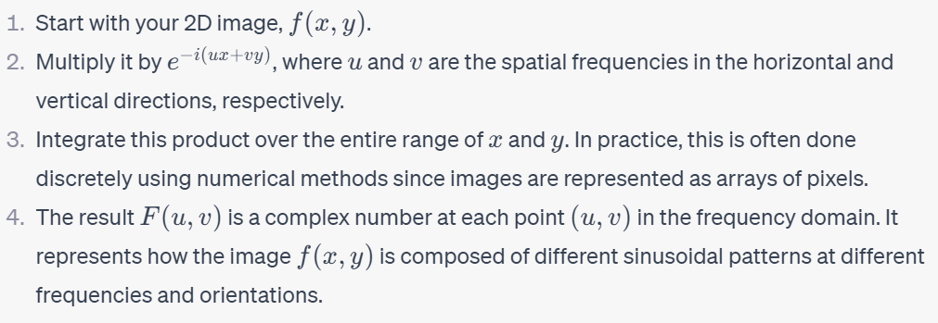
2D Transformation

Slide 24
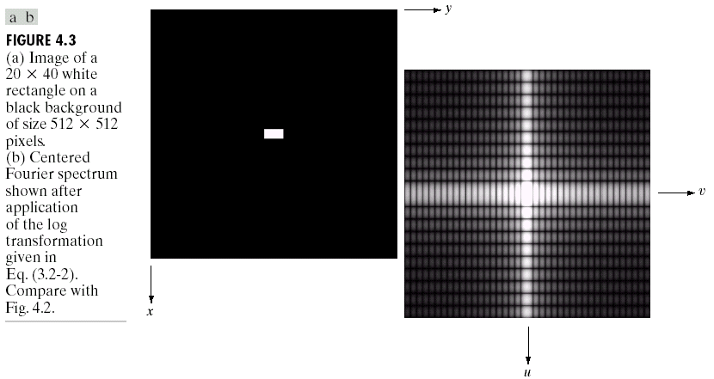
DFT & Images
The DFT of a two dimensional image can be visualised by showing the spectrum of the images component frequencies
DFT

Slide 25
DFT & Images

Slide 26
DFT & Images

Slide 27
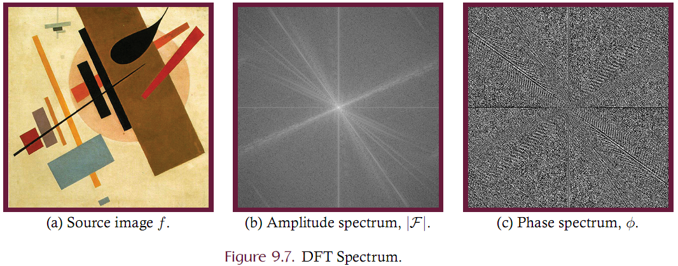
Magnitude Spectrum and Phase Spectrum

Slide 28
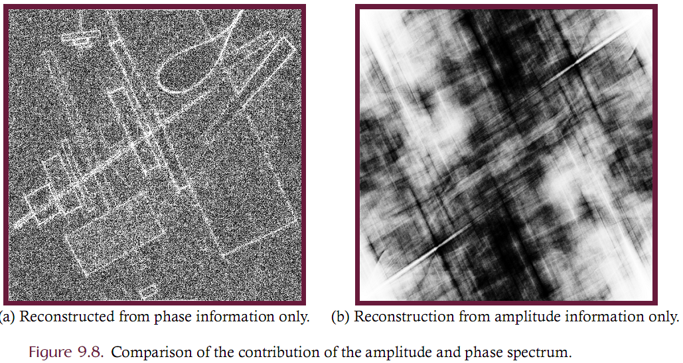
Magnitude Spectrum and Phase Spectrum

Slide 29
Magnitude Spectrum and Phase Spectrum
Notes on the magnitude spectrum:
Magnitudes are generally referred to as the “spectrum” but this should be understood as the magnitude spectrum.
Typically has an extremely large dynamic range and it is typical to log-compress those values for display (as in the previous slide)
For presentation, the DC component i.e., F(0,0), is placed at the center. Low frequency components are shown near the center and frequency increases with distance from center.

Slide 30
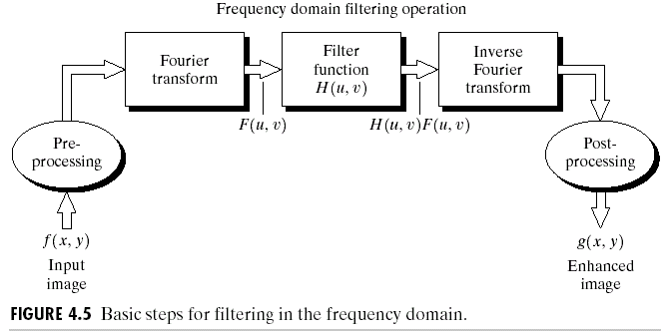
The DFT and Image Processing
To filter an image in the frequency domain:
Compute F(u,v) the DFT of the image
Multiply F(u,v) by a filter function H(u,v)
Compute the inverse DFT of the result

Slide 31
The Inverse DFT
It is really important to note that the Fourier transform is completely reversible
The inverse DFT is given by:
for x = 0, 1, 2…M-1 and y = 0, 1, 2…N-1

Slide 32
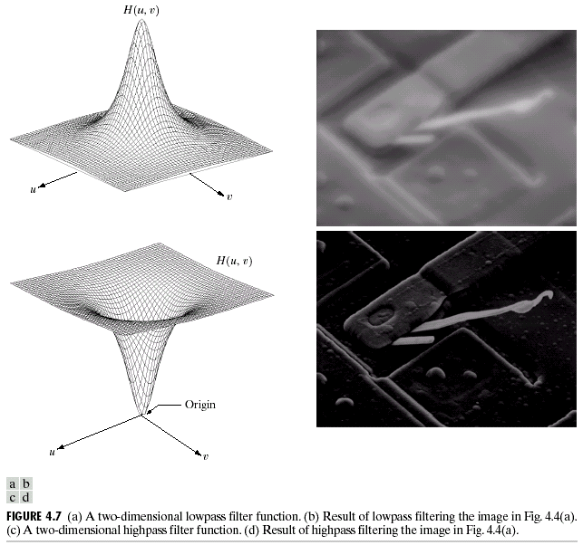
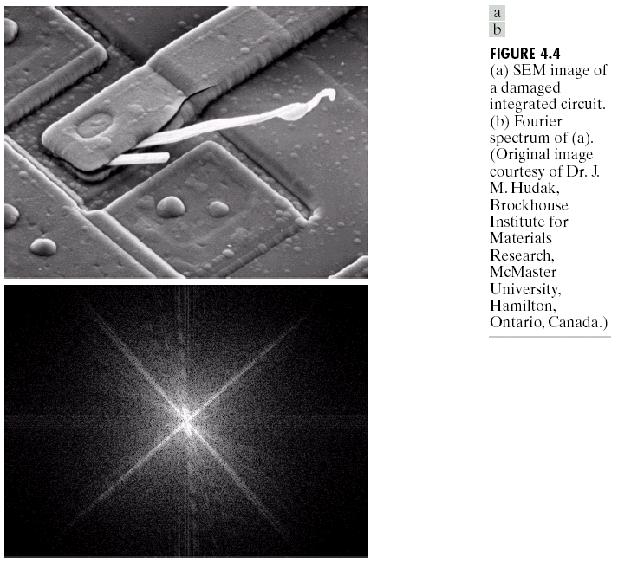
Some Basic Frequency Domain Filters
Low Pass Filter
High Pass Filter

Slide 33
Smoothing Frequency Domain Filters
Smoothing is achieved in the frequency domain by dropping out the high frequency components
The basic model for filtering is:
G(u,v) = H(u,v) x F(u,v)
where F(u,v) is the Fourier transform of the image being filtered and H(u,v) is the filter transform function
Low pass filters – only pass the low frequencies, drop the high ones

Slide 34
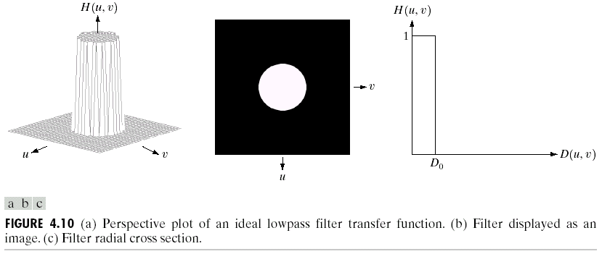
Ideal Low Pass Filter
Simply cut off all high frequency components that are a specified distance D₀ from the origin of the transform
changing the distance changes the behaviour of the filter

Slide 35
Ideal Low Pass Filter (cont…)
The transfer function for the ideal low pass filter can be given as:
where D(u,v) is given as:

Slide 36
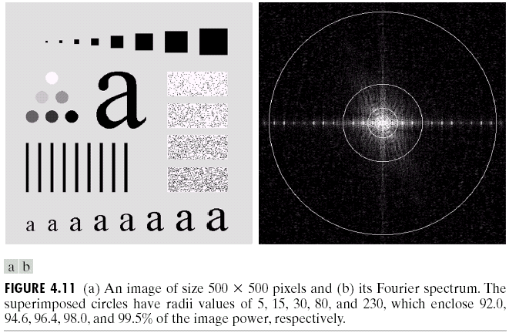
Ideal Low Pass Filter (cont…)
Above we show an image, it’s Fourier spectrum and a series of ideal low pass filters of radius 5, 15, 30, 80 and 230 superimposed on top of it

Slide 37
Ideal Low Pass Filter (cont…)

Slide 38
Ideal Low Pass Filter (cont…)

Slide 39
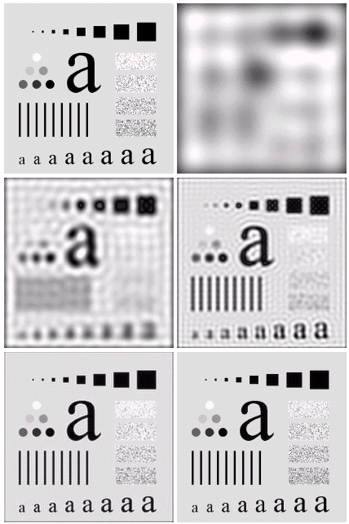
Ideal Low Pass Filter (cont…)
Result of filtering with ideal low pass filter of radius 5
Original image
Result of filtering with ideal low pass filter of radius 15
Result of filtering with ideal low pass filter of radius 30
Result of filtering with ideal low pass filter of radius 80
Result of filtering with ideal low pass filter of radius 230

Slide 40
Ideal Low Pass Filter (cont…)
Result of filtering with ideal low pass filter of radius 5

Slide 41
Ideal Low Pass Filter (cont…)
Result of filtering with ideal low pass filter of radius 15

Slide 42
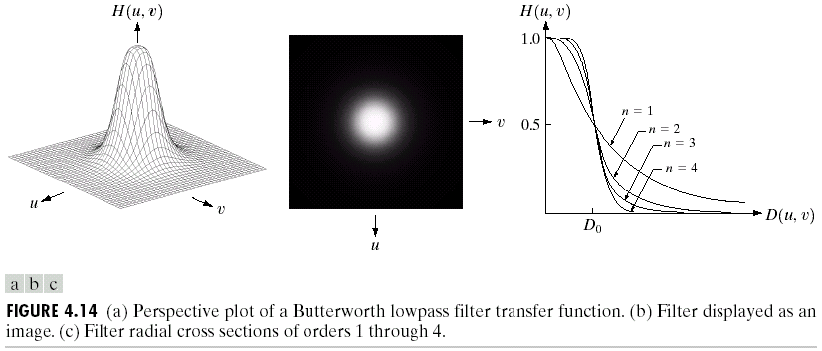
Butterworth Lowpass Filters
The transfer function of a Butterworth lowpass filter of order n with cutoff frequency at distance D₀ from the origin is defined as:

Slide 43
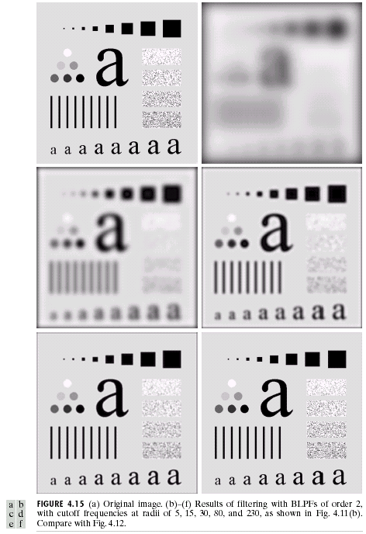
Butterworth Lowpass Filter (cont…)
Result of filtering with Butterworth filter of order 2 and cutoff radius 5
Original image
Result of filtering with Butterworth filter of order 2 and cutoff radius 15
Result of filtering with Butterworth filter of order 2 and cutoff radius 30
Result of filtering with Butterworth filter of order 2 and cutoff radius 80
Result of filtering with Butterworth filter of order 2 and cutoff radius 230

Slide 44
Butterworth Lowpass Filter (cont…)
Original image
Result of filtering with Butterworth filter of order 2 and cutoff radius 5

Slide 45
Butterworth Lowpass Filter (cont…)
Result of filtering with Butterworth filter of order 2 and cutoff radius 15

Slide 46
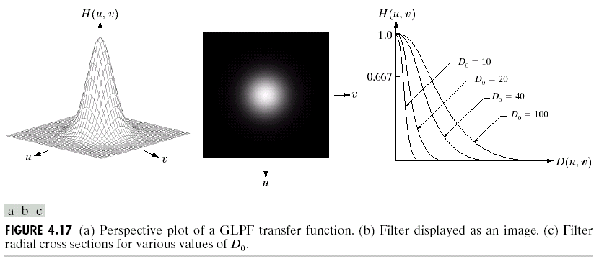
Gaussian Lowpass Filters
The transfer function of a Gaussian lowpass filter is defined as:

Slide 47
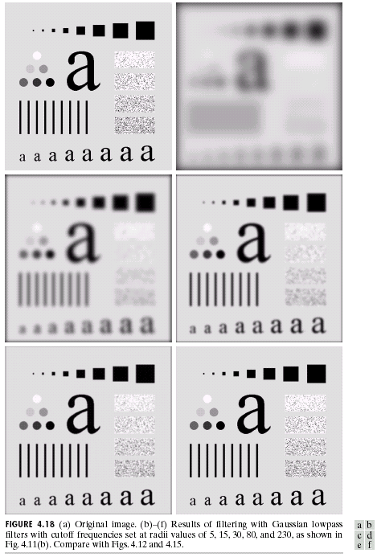
Gaussian Lowpass Filters (cont…)
Result of filtering with Gaussian filter with cutoff radius 5
Original image
Result of filtering with Gaussian filter with cutoff radius 15
Result of filtering with Gaussian filter with cutoff radius 30
Result of filtering with Gaussian filter with cutoff radius 85
Result of filtering with Gaussian filter with cutoff radius 230

Slide 48
Lowpass Filters Compared
Result of filtering with ideal low pass filter of radius 15
Result of filtering with Butterworth filter of order 2 and cutoff radius 15
Result of filtering with Gaussian filter with cutoff radius 15

Slide 49
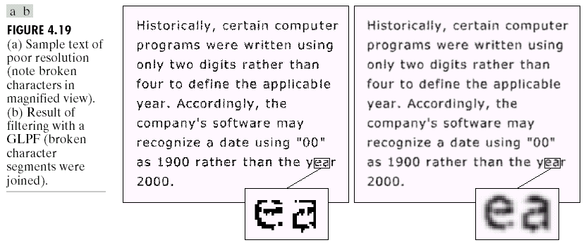
Lowpass Filtering Examples
A low pass Gaussian filter is used to connect broken text

Slide 50
Lowpass Filtering Examples

Slide 51
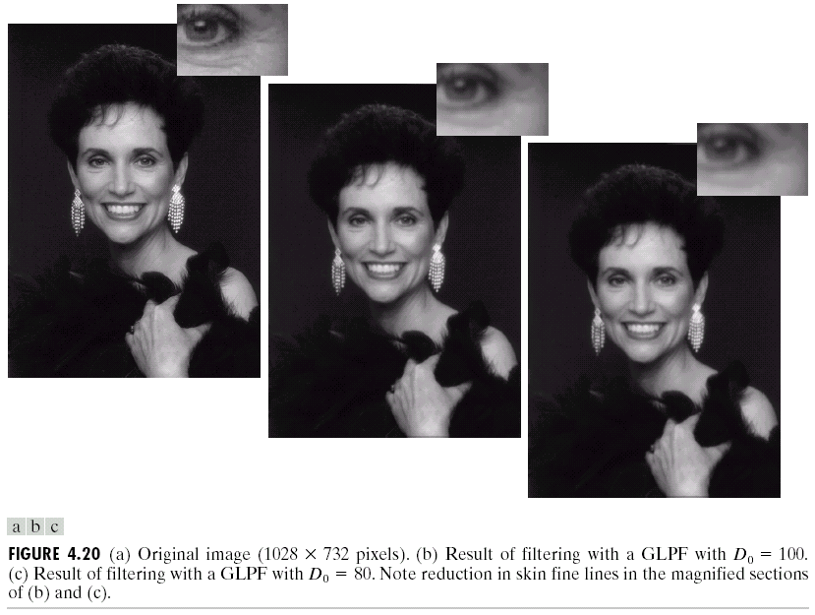
Lowpass Filtering Examples (cont…)
Different lowpass Gaussian filters used to remove blemishes in a photograph

Slide 52
Lowpass Filtering Examples (cont…)

Slide 53
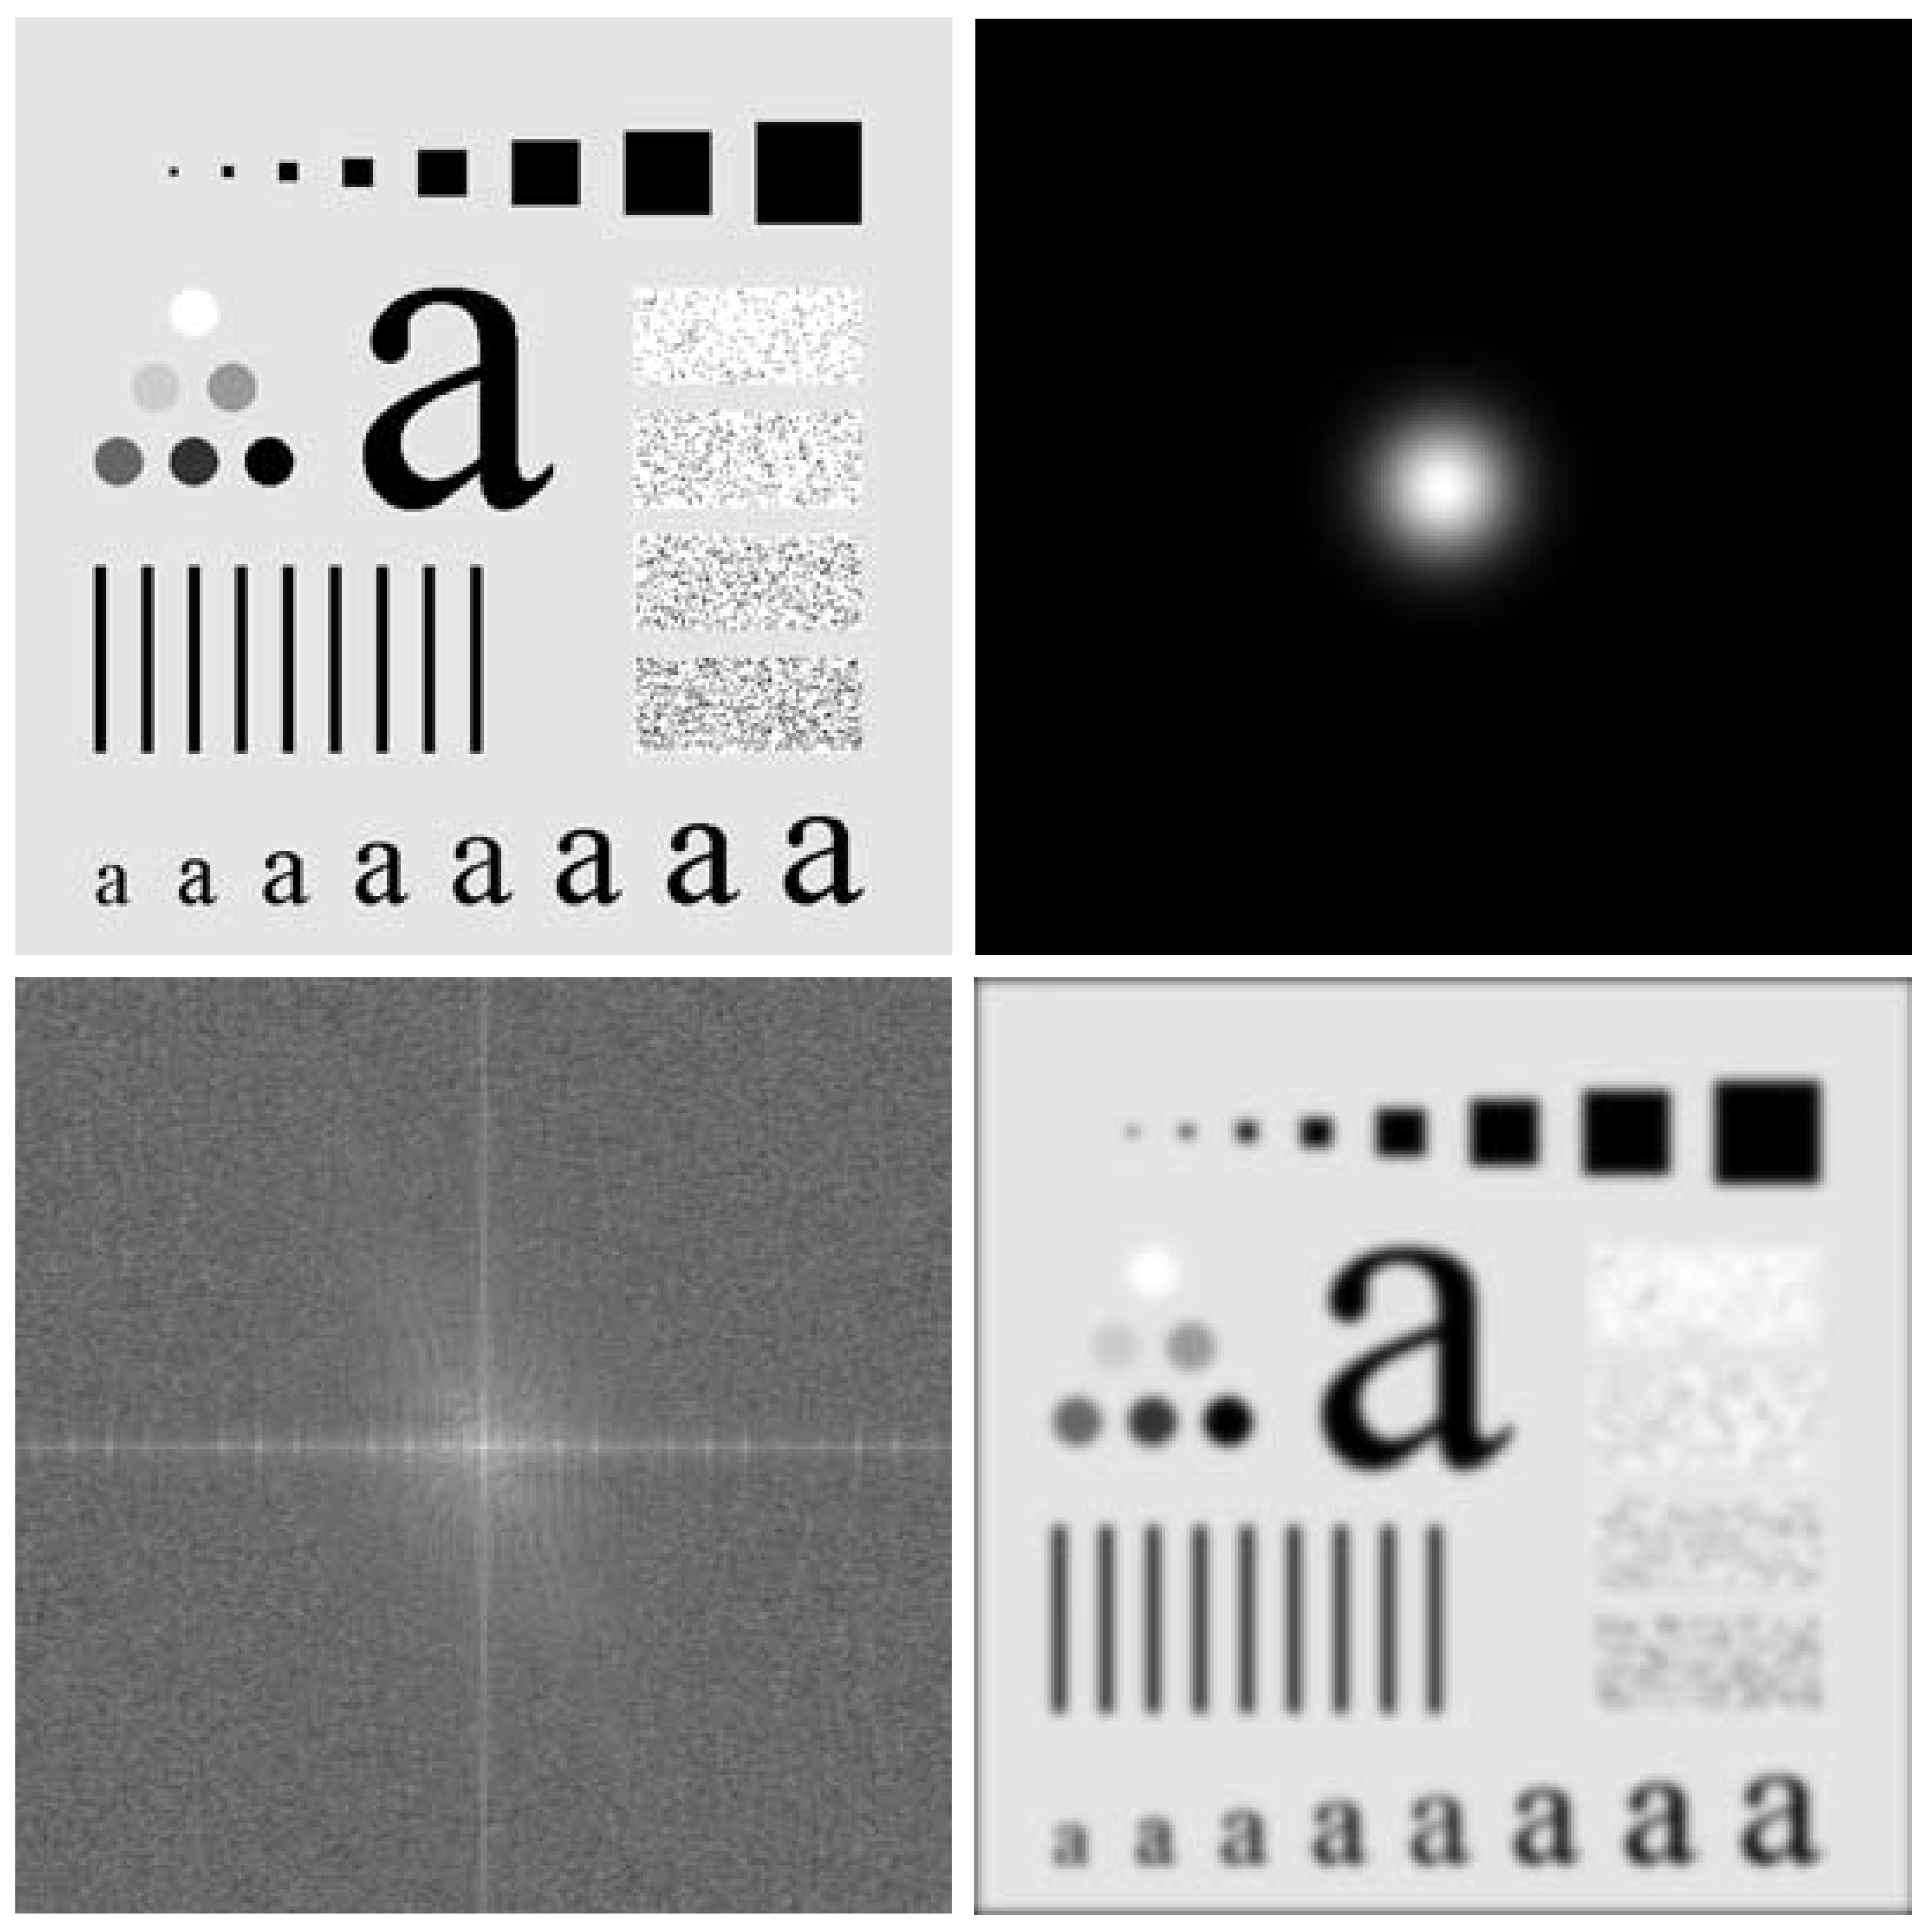
Lowpass Filtering Examples (cont…)
Original image
Gaussian lowpass filter
Spectrum of original image
Processed image

Slide 54
Sharpening in the Frequency Domain
Edges and fine detail in images are associated with high frequency components
High pass filters – only pass the high frequencies, drop the low ones
High pass frequencies are precisely the reverse of low pass filters, so:
H_{hp}(u, v) = 1 – H_{lp}(u, v)

Slide 55
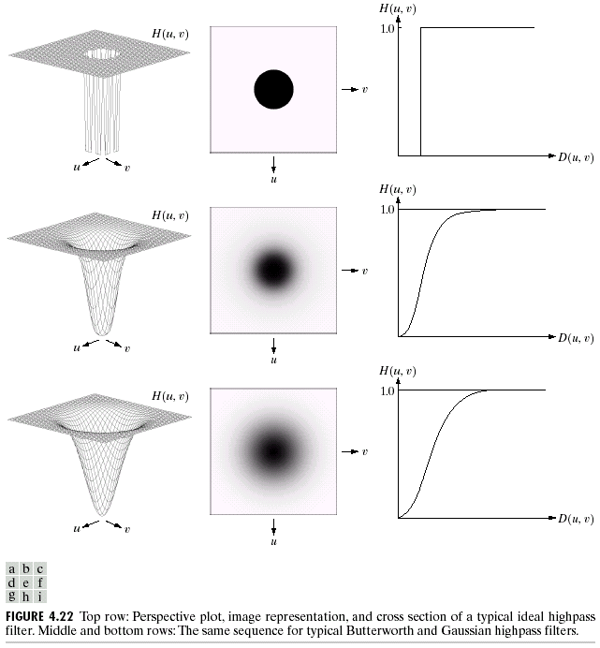
Ideal High Pass Filters
The ideal high pass filter is given as:
where D₀ is the cut off distance as before

Slide 56
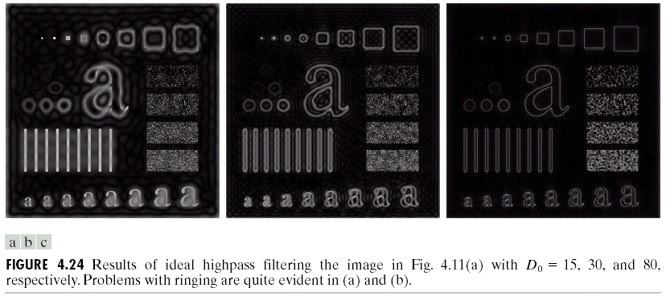
Ideal High Pass Filters (cont…)
Results of ideal high pass filtering with D₀ = 15
Results of ideal high pass filtering with D₀ = 30
Results of ideal high pass filtering with D₀ = 80

Slide 57
Summary
In this lecture we examined image enhancement in the frequency domain
The Fourier series & the Fourier transform
Image Processing in the frequency domain
Image smoothing
Image sharpening
Next time we will begin to examine image restoration using the spatial and frequency based techniques we have been looking at

Slide 58
Butterworth High Pass Filters
The Butterworth high pass filter is given as:
where n is the order and D₀ is the cut off distance as before

Slide 59
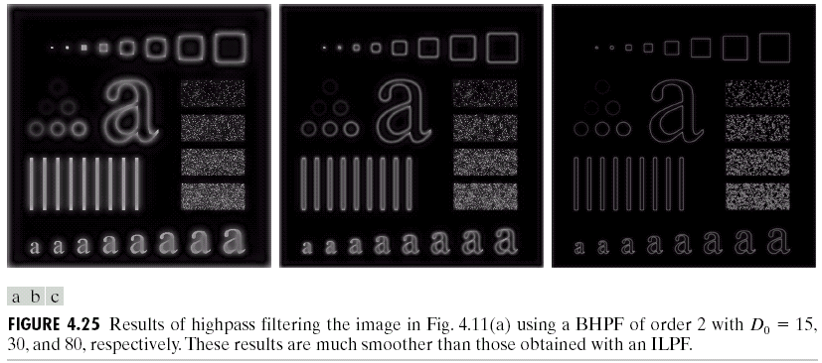
Butterworth High Pass Filters (cont…)
Results of Butterworth high pass filtering of order 2 with D₀ = 15
Results of Butterworth high pass filtering of order 2 with D₀ = 80
Results of Butterworth high pass filtering of order 2 with D₀ = 30

Slide 60
Gaussian High Pass Filters
The Gaussian high pass filter is given as:
where D₀ is the cut off distance as before

Slide 61
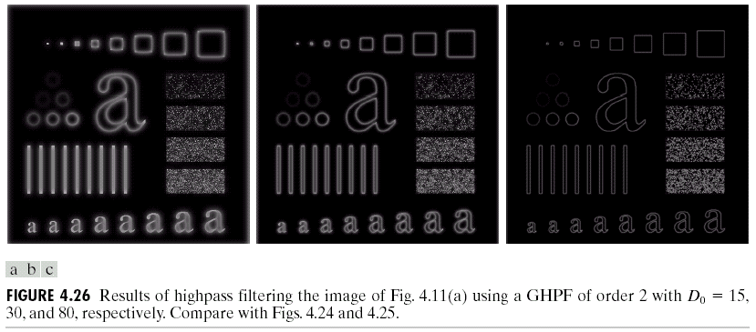
Gaussian High Pass Filters (cont…)
Results of Gaussian high pass filtering with D₀ = 15
Results of Gaussian high pass filtering with D₀ = 80
Results of Gaussian high pass filtering with D₀ = 30

Slide 62
Highpass Filter Comparison
Results of ideal high pass filtering with D₀ = 15

Slide 63
Highpass Filter Comparison
Results of Butterworth high pass filtering of order 2 with D₀ = 15

Slide 64
Highpass Filter Comparison
Results of Gaussian high pass filtering with D₀ = 15

Slide 65
Highpass Filter Comparison
Results of ideal high pass filtering with D₀ = 15
Results of Butterworth high pass filtering of order 2 with D₀ = 15
Results of Gaussian high pass filtering with D₀ = 15

Slide 66
Highpass Filter Comparison
Results of ideal high pass filtering with D₀ = 15

Slide 67
Highpass Filter Comparison
Results of Butterworth high pass filtering of order 2 with D₀ = 15

Slide 68
Highpass Filter Comparison
Results of Gaussian high pass filtering with D₀ = 15

Slide 69
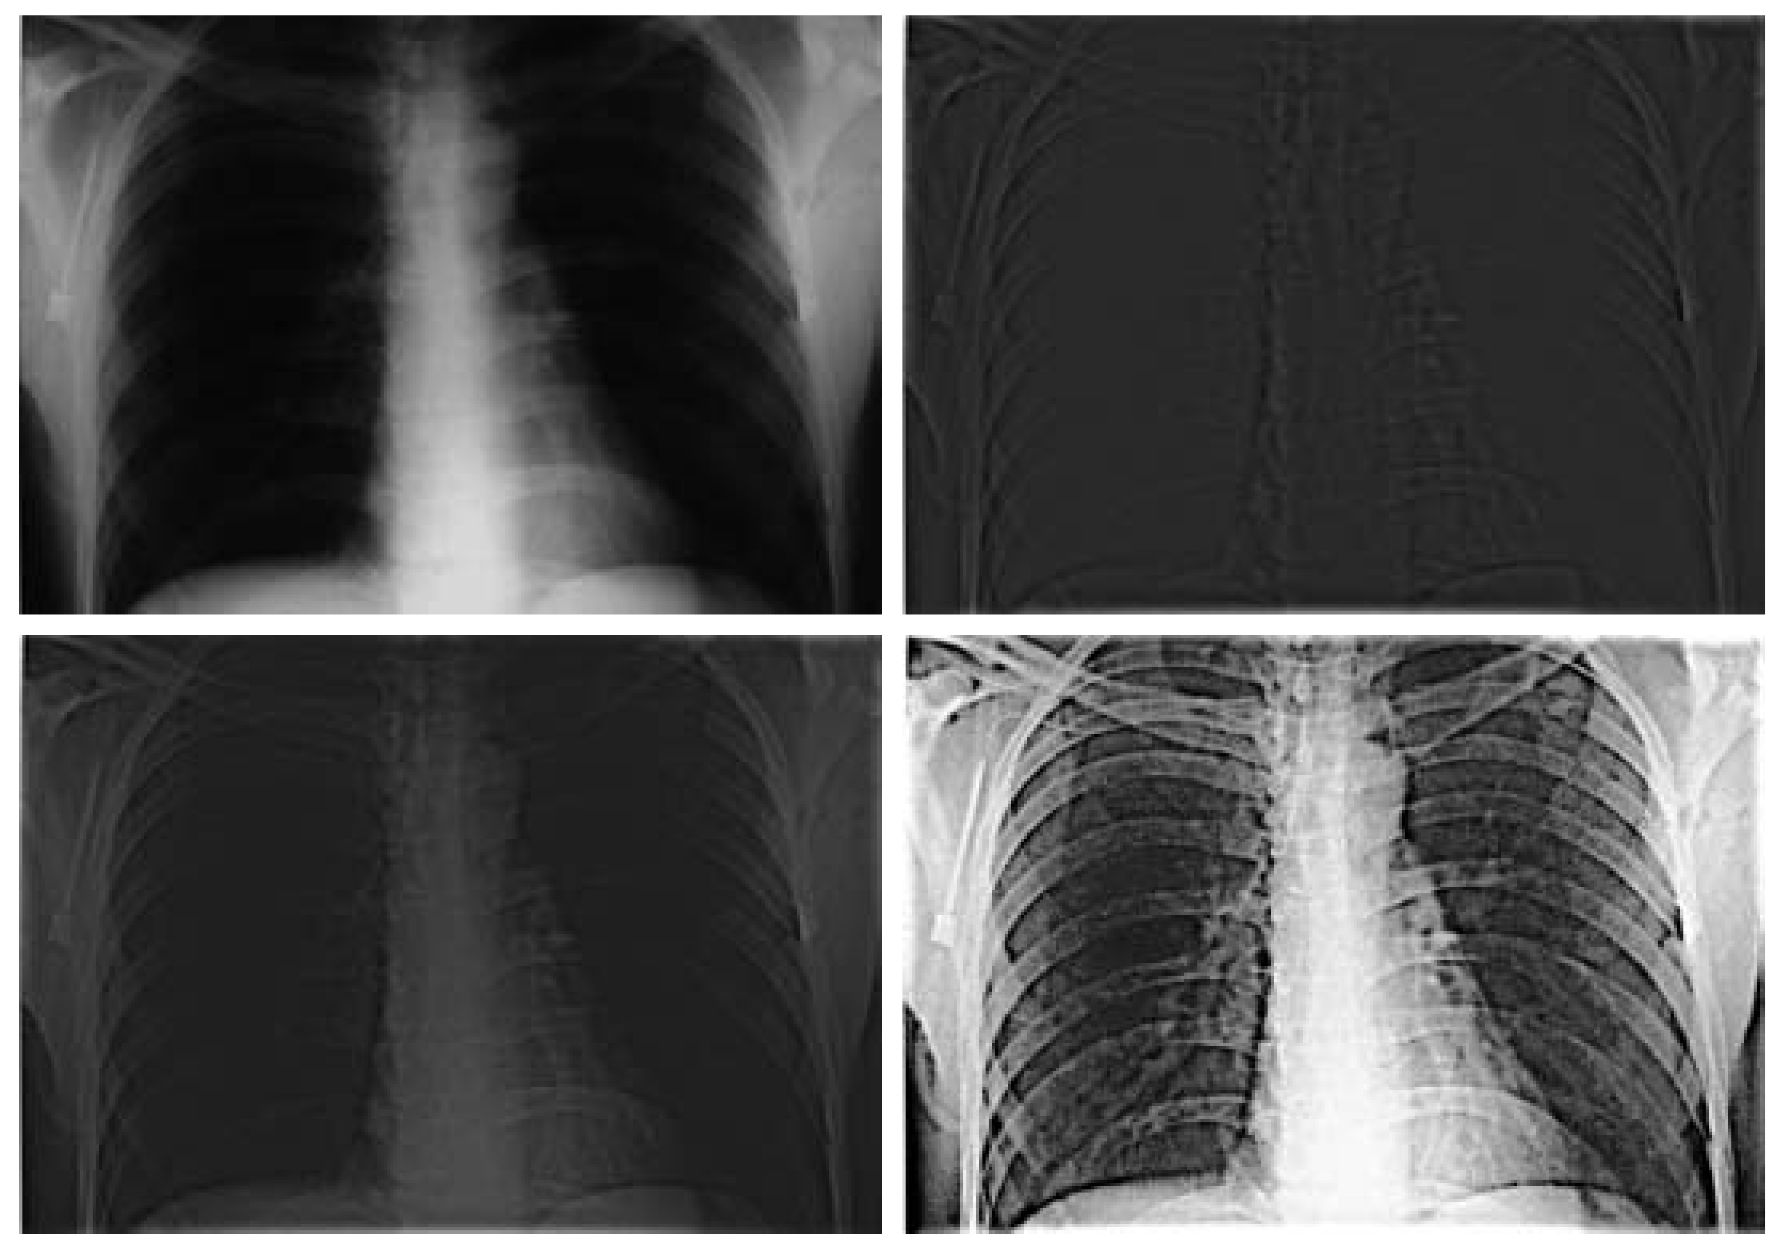
Highpass Filtering Example
Original image
Highpass filtering result
High frequency emphasis result
After histogram equalisation

Slide 70
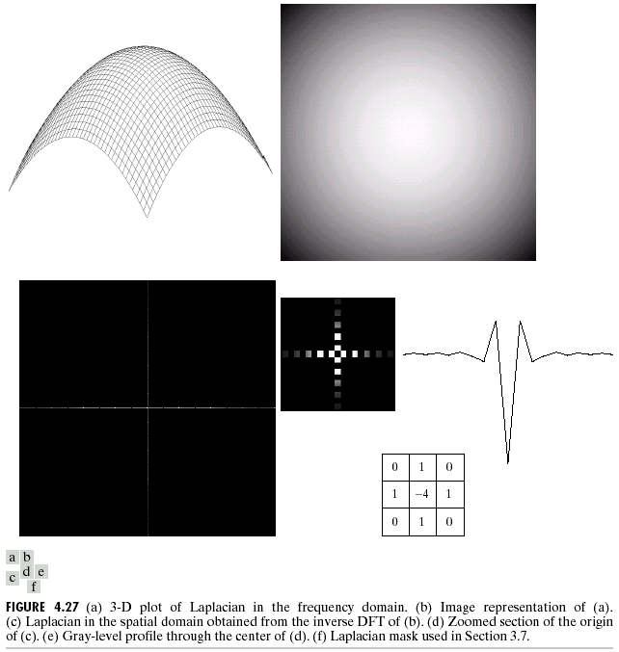
Laplacian In The Frequency Domain
2-D image of Laplacian in the frequency domain
Laplacian in the frequency domain
Inverse DFT of Laplacian in the frequency domain
Zoomed section of the image on the left compared to spatial filter

Slide 71
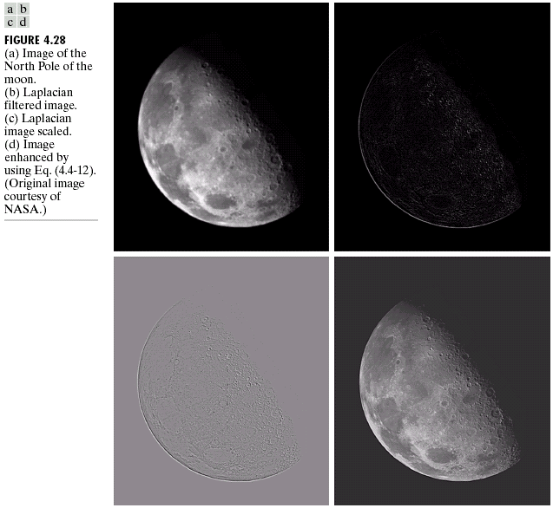
Frequency Domain Laplacian Example
Original image
Laplacian filtered image
Laplacian image scaled
Enhanced image

Slide 72
Fast Fourier Transform
The reason that Fourier based techniques have become so popular is the development of the Fast Fourier Transform (FFT) algorithm
Allows the Fourier transform to be carried out in a reasonable amount of time
Reduces the amount of time required to perform a Fourier transform by a factor of 100 – 600 times!

Slide 73
Frequency Domain Filtering & Spatial Domain Filtering
Similar jobs can be done in the spatial and frequency domains
Filtering in the spatial domain can be easier to understand
Filtering in the frequency domain can be much faster – especially for large images

Slide 74
Summary
In this lecture we examined image enhancement in the frequency domain
The Fourier series & the Fourier transform
Image Processing in the frequency domain
Image smoothing
Image sharpening
Fast Fourier Transform
Next time we will begin to examine image restoration using the spatial and frequency based techniques we have been looking at

Slide 75
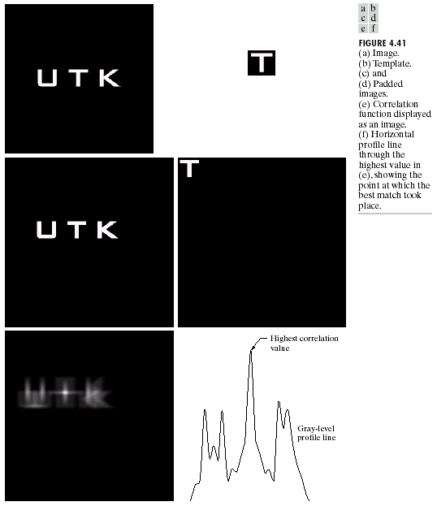
Imteresting Application Of Frequency Domain Filtering

Slide 76
Imteresting Application Of Frequency Domain Filtering

Slide 77
Questions?
?

Slide 78
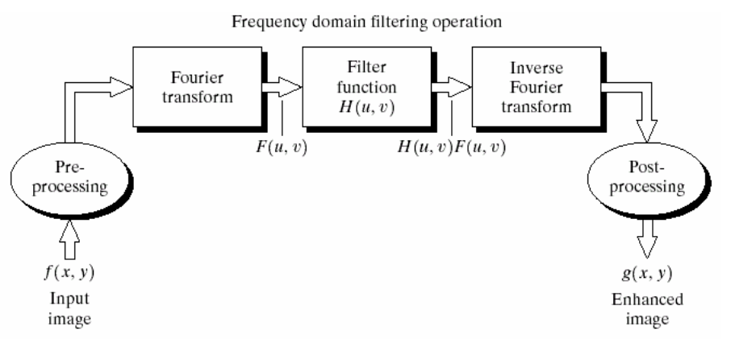
DFT application #1: fast convolution
O(N²/log₂N)
O(N²)
O(N²/log₂N)
Spatial filtering
f(x.y)*h(x.y)
O(N⁴)

